Slide 1
SENTIMENTAL ANALYSIS OF COVID 19 PANDEMIC
(USA)
KDD Project
Group -3
Brenda Ondieki
Sarika Vemana

Slide 2
Agenda
>Introduction
> History
> EDA
> Modelling
>Conclusion

Slide 3
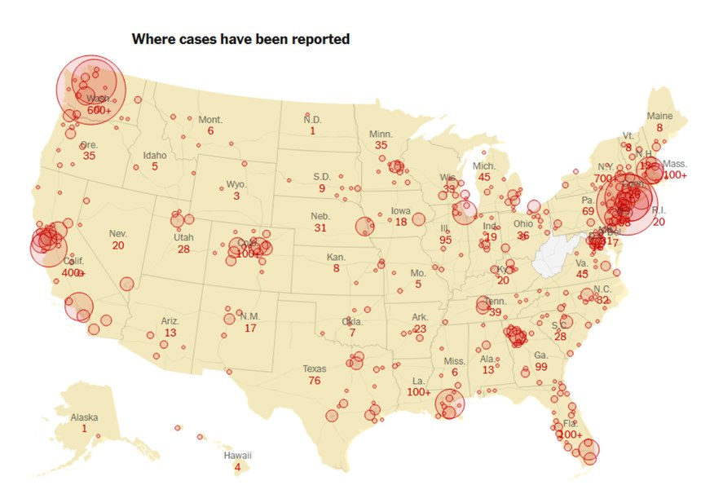
USA's COVID-19 Experience
Notes:
Being the 3rd most populous country in the world, USA experienced one of the highest COVID-19 case and death rates globally, significantly impacting healthcare systems, economies, and communities.
However, the quick development and distribution of vaccinations played a critical role in minimizing the pandemic's damage. This achievement not only saved millions of lives, but also demonstrated the importance of scientific innovation and global collaboration in responding to public health crises.

Slide 4


Introduction
> Covid initiation - January 21st 2020
> Peak Feb - March 2020.
> By mid-April, all States had increasing cases.
> A second wave of infections began in June, surpassing 60,000.
>By mid-October, third surge of cases began; over 200,000 new daily cases.
>By end of year (2020) 20M cases enrolled.
Notes:
In January 2020, the first COVID-19 case was confirmed in Washington state.
the first wave occurs between March 2020 and June 2020,
the second wave occurs between July 2020 and mid-Oct 2020,
the third one occurs between November 2020 and March 2021.
Demir M, Aslan IH, Lenhart S. Analyzing the effect of restrictions on the COVID-19 outbreak for some US states. Theor Ecol. 2023;16(2):117-129. doi: 10.1007/s12080-023-00557-1. Epub 2023 Apr 25. PMID: 37284010; PMCID: PMC10126528.

Slide 5
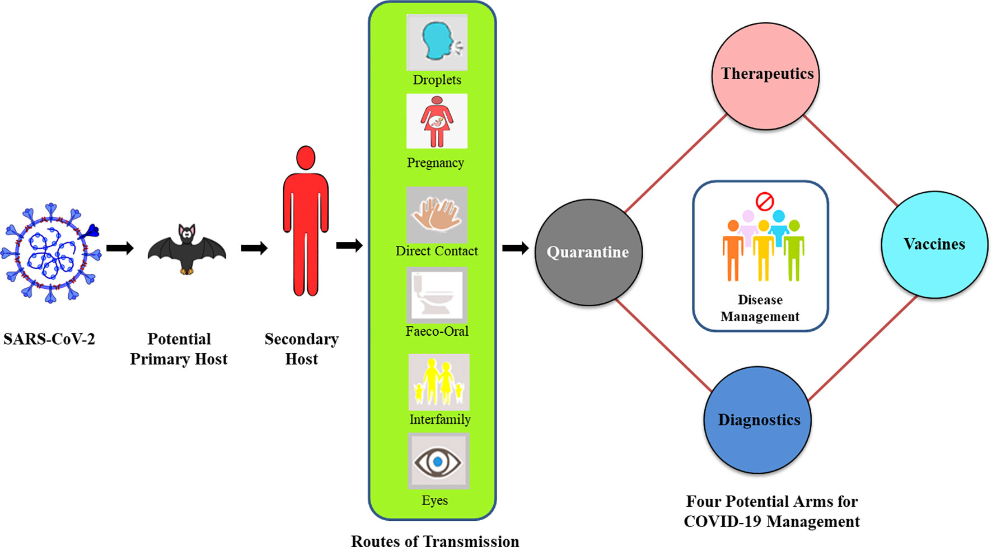
Some Historical Content
> Origin of the pandemic - Wuhan, China
> SARS CoV -2 & Different variants
Omicron ( SA - Nov 2021)
Delta ( IN - Late 2021)
> Routes of Transmission
> Management
Notes:
-In dec 2019
-severe acute respiratory syndrome coronavirus 2 (SARS-CoV-2)
-Bats having the similar kind virus present in their body became the primary host and eventually humans became secondary host
-different variants Omicron (first case Nov 2021 in South Africa) and Delta (first case Oct 2020 in India but became calm and had huge surge in late 2021, )
Routes of Transmission:
Vaccines : Pfizer Bio-Ntech, Moderna mRna, Johnson-johnson

Slide 6
Source of Datasets
Cases https://usafacts.org/visualizations/coronavirus-covid-19-spread-map/
Deaths https://usafacts.org/visualizations/coronavirus-covid-19-spread-map/
Vaccinations https://raw.githubusercontent.com/owid/covid-19-data/refs/heads/master/public/data/vaccinations/us_state_vaccinations.csv
Tweets data https://www.kaggle.com/datasets/bathierno/covid-19-cleaned-us-dataset
Notes:
Cases- usa facts.org Usa facts website - documents the cases & deaths of USA
Deaths - usa facts.org
Vacci- Our World in Data - github account
Tweets from Kaggle

Slide 7
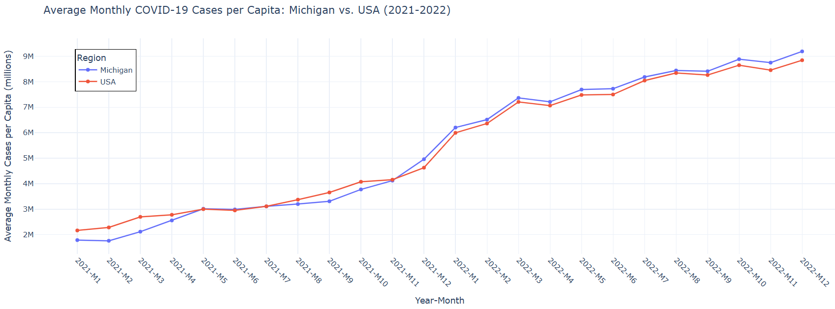
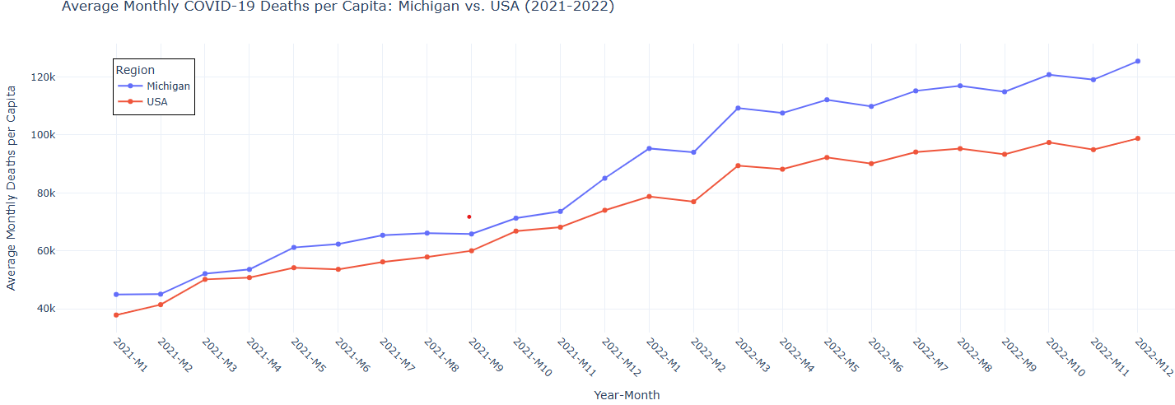
Exploratory Data Analysis
Notes:
We initially have data on daily basis starting from Jan 2020 till July 2023 each day documenting how many were present end of day. Filtered-groupedby-aggregated-percapita for a fair comparison
The chart visualizes the average monthly COVID-19 cases per capita for Michigan and the USA, with separate lines for each region and markers for data points.
Trend Analysis: Case rates for Michigan and the USA align closely until late 2021, after which Michigan starts to lag slightly behind the national trend.
Spike in Cases: The late 2021 and early 2022 spikes are associated with the emergence of the Omicron variant, which was more transmissible but less lethal than previous strains.
Drop in Cases: The decrease in mid-2022 is likely due to widespread immunity (vaccination and prior infections) and seasonality factors.
Deaths
The chart visualizes the average monthly COVID-19 cases per capita for Michigan and the USA, with separate lines for each region and markers for data points.
Trend Analysis: The death rates in Michigan remain consistently higher than the national average throughout 2021–2022. There is a notable increase in deaths around late 2021 (October–December) for both Michigan and the USA.
Spike in Deaths: The late 2021 spike corresponds to the Delta variant wave, which was highly transmissible and caused severe outcomes, particularly among unvaccinated populations. Limited resources of hospitals due to sudden surge , older individuals,
Drop in Deaths: Following early 2022, death rates begin to stabilize, likely due to increased vaccination rates, booster campaigns, and improved treatments such as antivirals.

Slide 8
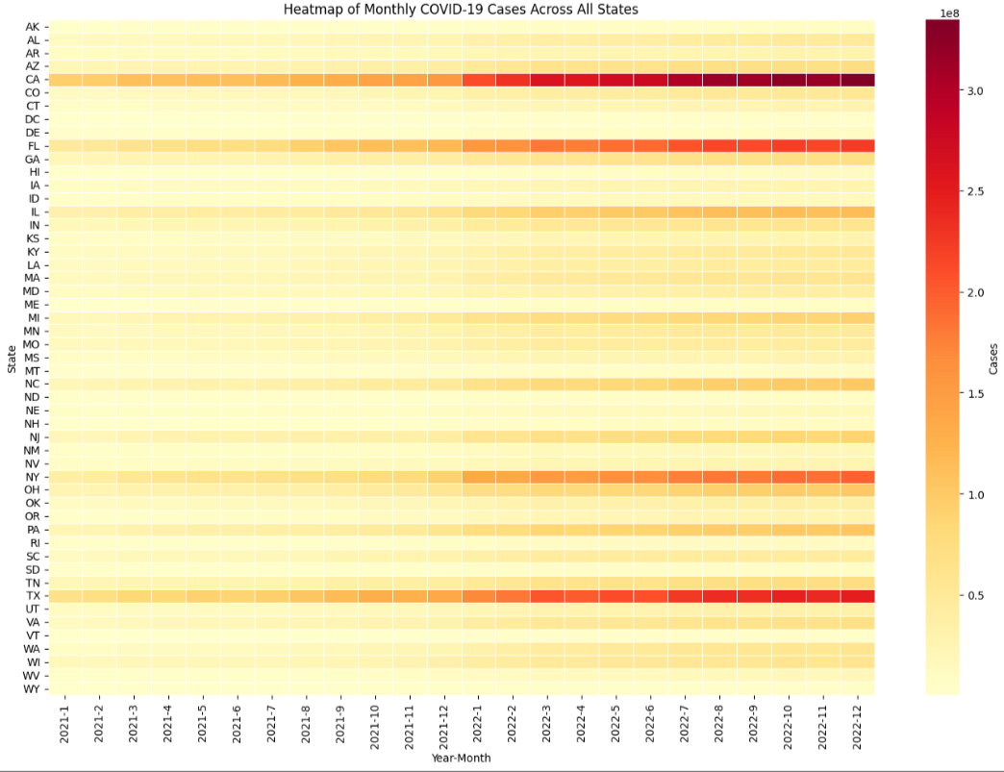
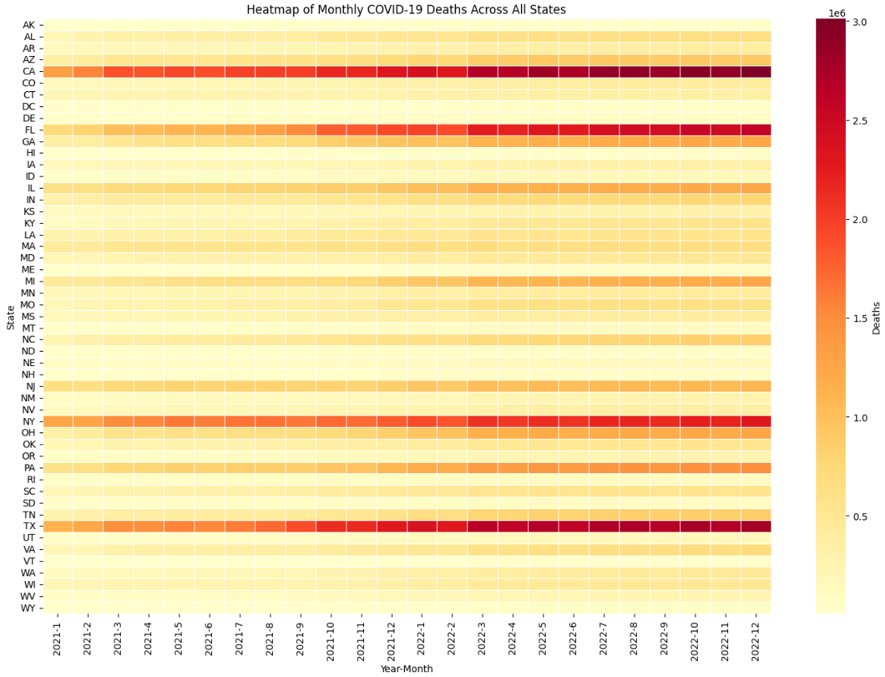
Notes:
heatmap to visualize the monthly total COVID-19 cases and deaths across all U.S. states. The data is first transformed into a pivot table with states as rows, year-month combinations as columns, and the sum of cases and deaths as values, which is then plotted using the seaborn heatmap function.
We see that high density of color can be seen in states like CA, TX, NY, FL,PA

Slide 9
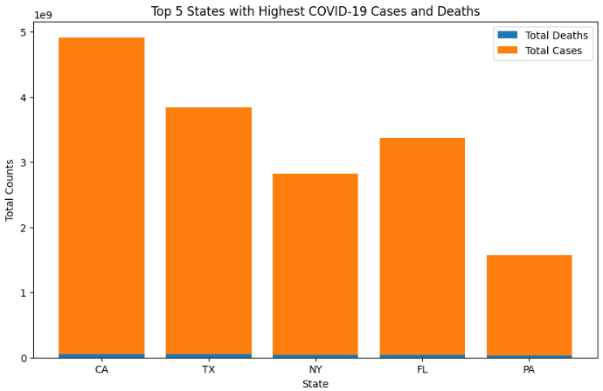
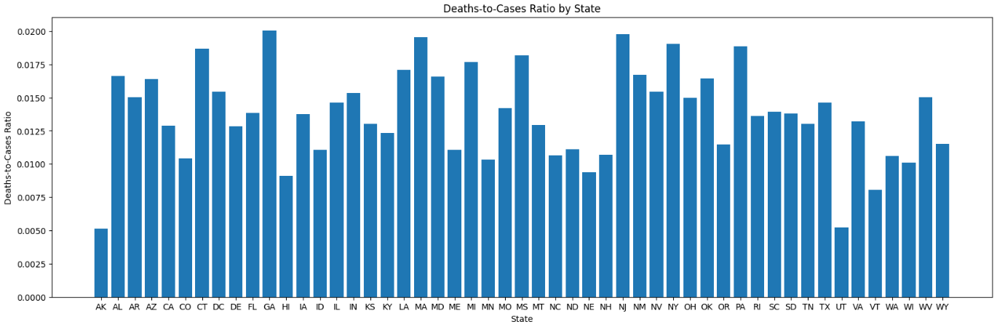
Notes:
the top 5 states with the highest total COVID-19 deaths by summing up data grouped by state and sorting them in descending order. It then creates a stacked bar chart to compare the total deaths and cases in these states, with deaths forming the lower part of each bar and cases stacked on top, providing a clear visual comparison.
California, Texas, New York, Florida, and Pennsylvania have had a high number of COVID-19 cases and deaths due to their huge populations, urban density, and early virus epicenters, such as New York. State-specific rules, such as Florida's early reopening and Texas' uneven enforcement of prohibitions, contributed to the increase. Furthermore, these states experienced severe healthcare system strain, particularly during waves caused by highly transmissible variations. Population statistics, particularly among elderly people, increased sensitivity to severe outcomes.
Ratio
calculates the deaths-to-cases ratio for each state by dividing the total deaths by the total cases in the dataset and groups the data by state to compute the average ratio. A bar chart is then plotted to visualize this ratio for each state, showing variations in mortality relative to reported cases.
States like Florida and Georgia exhibit higher ratios, potentially due to older populations and healthcare system strain during surges. States like Vermont and Hawaii have lower ratios, which may be attributed to better public health measures, higher vaccination rates, and younger populations.

Slide 10
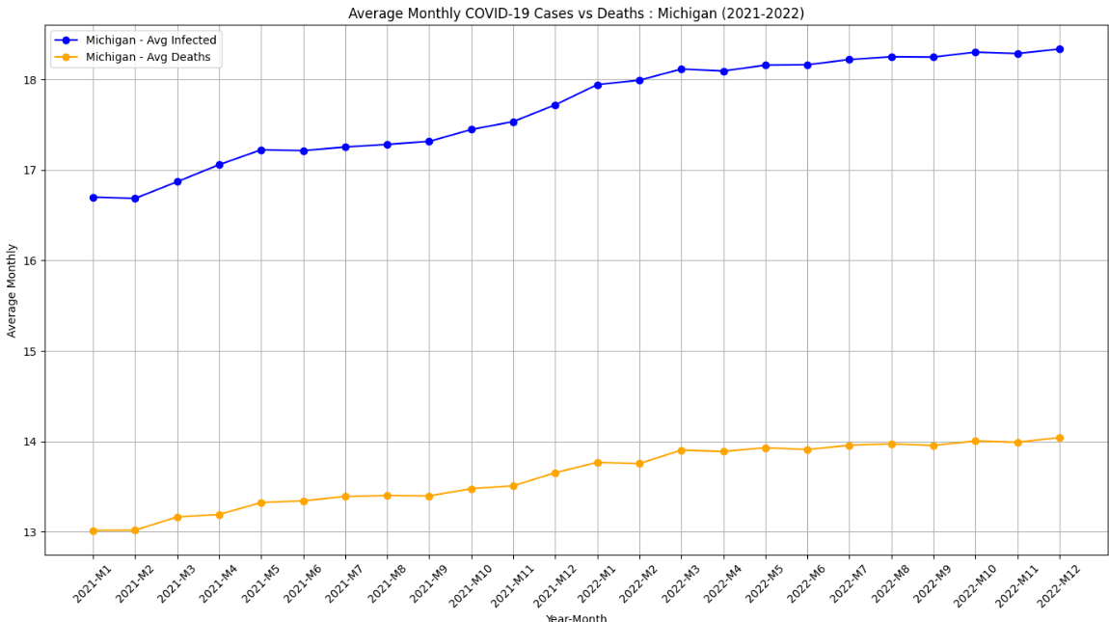
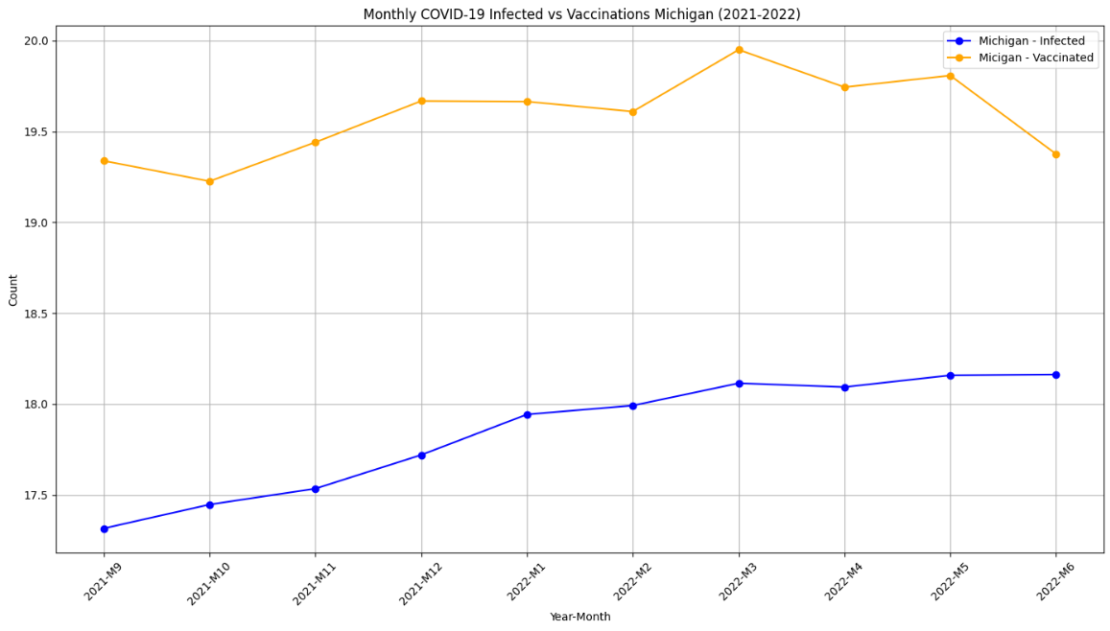
Michigan Trends
Notes:
the logarithmic values of the 'Cases' - 'Deaths', and Cases and Vaccinations to normalize the data and handle large values more effectively.
C-D
The blue line shows a steady increase in average monthly infections, peaking around late 2021 and early 2022, likely due to the Omicron variant, which caused widespread but generally less severe illness than Delta. The orange line also rises, but at a slower rate, reflecting improved treatments, widespread vaccination, and the less severe nature of Omicron. The widening gap between cases and deaths highlights the effectiveness of vaccines and treatments in reducing mortality despite the rise in infections.
Used inner join to merge data to get common data
C-V
The vaccination curve (orange) starts high, dips slightly in late 2021, and stabilizes until mid-2022 before declining, reflecting initial vaccination efforts followed by a drop in demand. Infections (blue) gradually rise, with notable spikes in late 2021 and early 2022, corresponding to new variant waves. The relatively stable vaccination rate in Michigan helped reduce the severity of cases, but could not fully prevent infection surges.

Slide 11
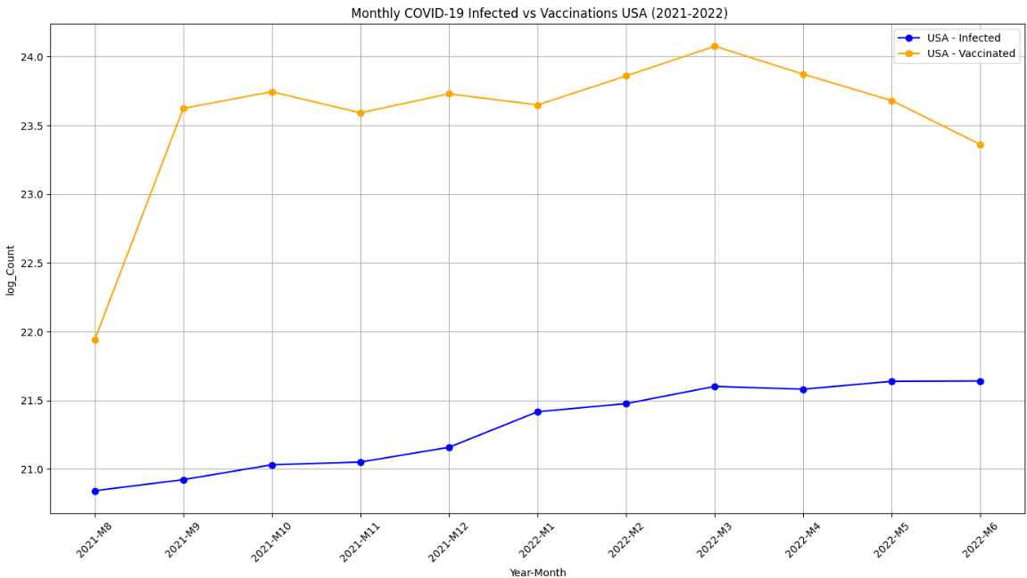
Overall USA
Notes:
The orange line depicts the monthly vaccination count, which peaks in August 2021, continues high, and then drops dramatically after May 2022, potentially due to vaccine saturation or decreased demand. Despite vaccine efforts, infection rates (blue) are constantly increasing, most likely due to variations like as Delta and Omicron. The disparity between rising infections and declining vaccination rates shows that the virus continued to propagate in vaccinated populations, possibly due to fading protection or immunological escape variations.

Slide 12
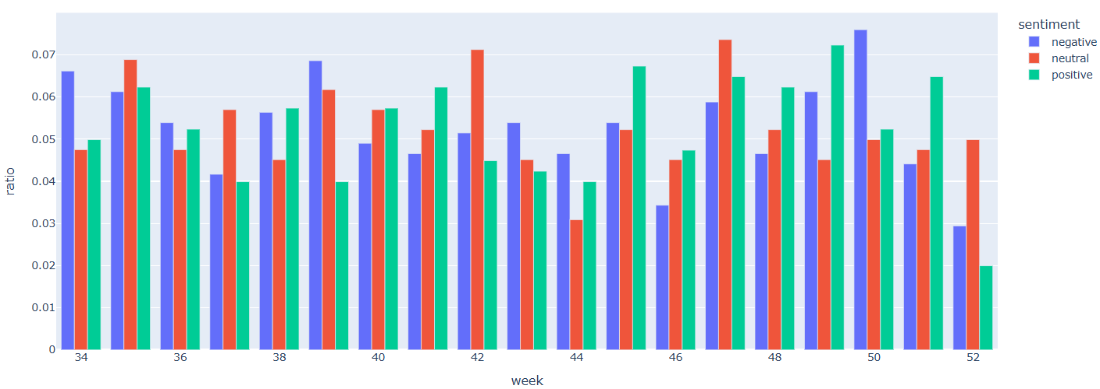
Weekly Sentiment Trends
Notes:
Neutral sentiment dominated throughout the weeks, reflecting ongoing public discussions around COVID-19 updates, vaccine rollouts, and policy changes. Positive sentiment increased toward the end of the year, driven by holiday optimism, vaccination milestones, and reports of reduced Omicron variant severity, but it dipped in week 52 due to concerns over Omicron’s rapid spread, travel disruptions, and renewed restrictions. Mid-year weeks (34–44) showed balanced sentiment, as Delta variant surges and vaccine hesitancy created public anxiety despite progress in vaccinations. Negative sentiment spiked slightly in early fall (weeks 40–44) amid fears of a pandemic resurgence, while weeks 46–50 saw rising positive sentiment as booster campaigns expanded and year-end celebrations uplifted public morale.

Slide 13
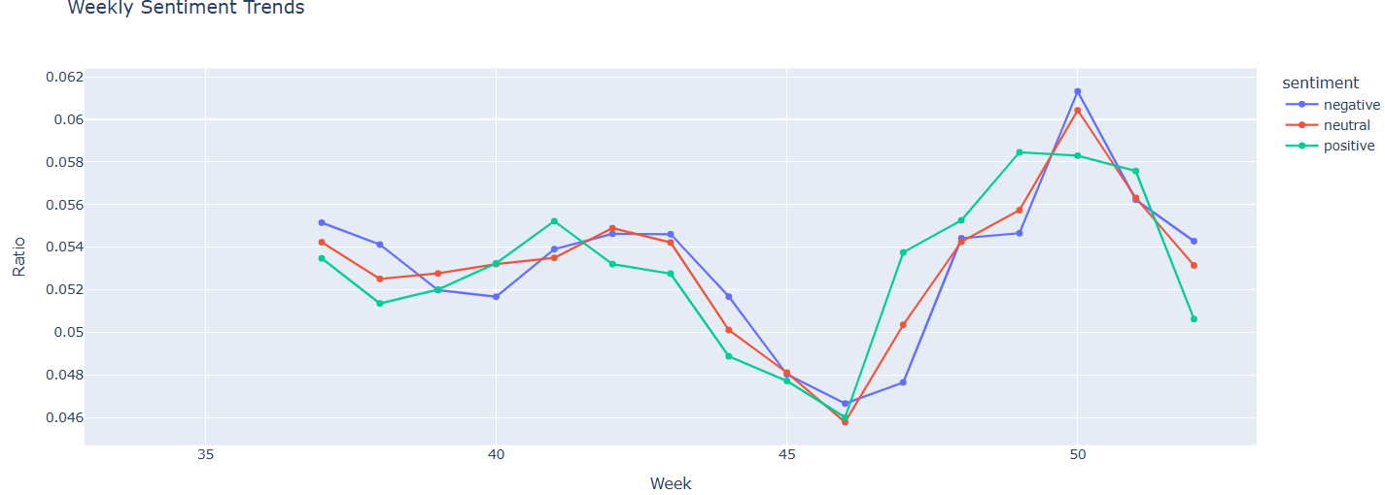
Notes:
The chart shows a dip in all sentiments (positive, neutral, and negative) around weeks 45–46, likely reflecting uncertainty and fatigue as concerns over the Delta variant and approaching colder months grew. Positive sentiment rose sharply during weeks 47–50, simultaneously with optimism from expanded booster campaigns, holiday anticipation, and early reports of Omicron's milder severity. Neutral sentiment peaked in week 50, likely reflecting factual discussions about Omicron’s rapid spread and its impact on holiday plans, travel, and healthcare systems. By week 52, positive sentiment dropped significantly, likely due to renewed restrictions, travel disruptions, and rising global anxiety over Omicron, while neutral sentiment also declined and negative sentiment remained steady but low.

Slide 14
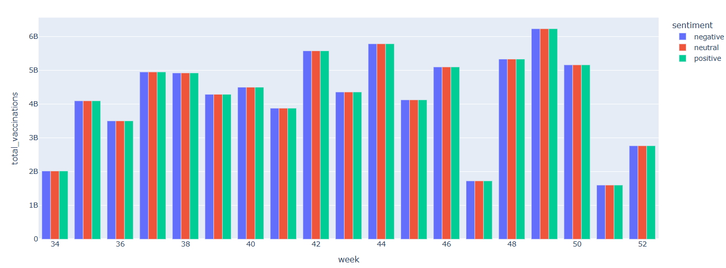
Total Vaccinations Per Week and Sentiment Trends
Notes:
The chart shows a steady increase in vaccinations from week 34 to week 44, reflecting the global push to combat the Delta variant and expand vaccination coverage, with neutral sentiment dominating, likely driven by factual discussions and updates. Positive sentiment peaks during high vaccination weeks (, weeks 44 and 48–50), indicating optimism about the rollout's progress, while negative sentiment remains relatively consistent, likely reflecting vaccine skepticism or criticism. The sharp drop in vaccinations in week 52 aligns with holiday disruptions, difficulties in managing and delivering COVID-19 vaccines, and the rapid spread of the Omicron variant, which created uncertainty and vaccination progress slowed during this period.

Slide 15
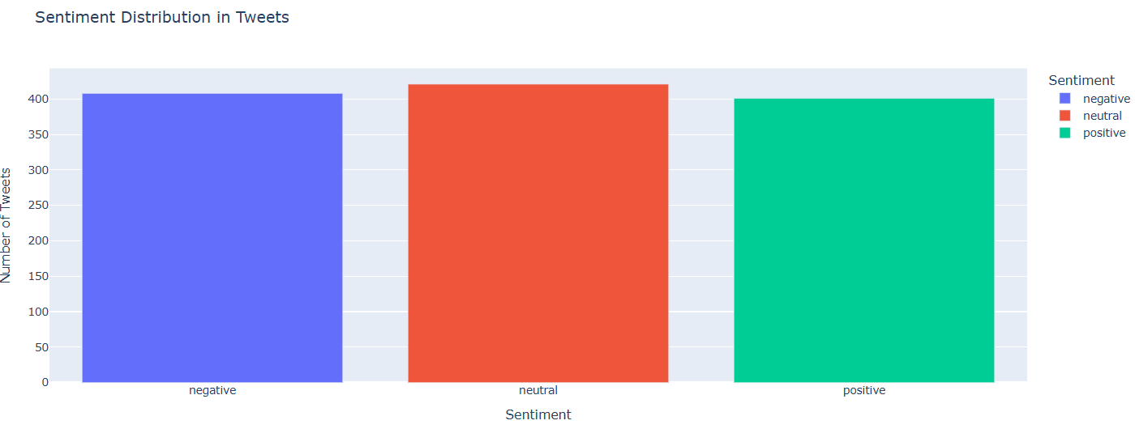
Notes:
The chart shows that neutral sentiment is slightly more dominant compared to positive and negative sentiments, indicating that many tweets focused on sharing factual information or updates about COVID-19 rather than expressing strong opinions. Positive and negative sentiments are almost equally distributed, reflecting a balance between optimism ( related to vaccination progress) and concerns or criticism (about variants or restrictions). Overall, the distribution suggests that public discussions on COVID-19 included a mix of emotions but leaned heavily toward neutral, fact-based content.

Slide 16
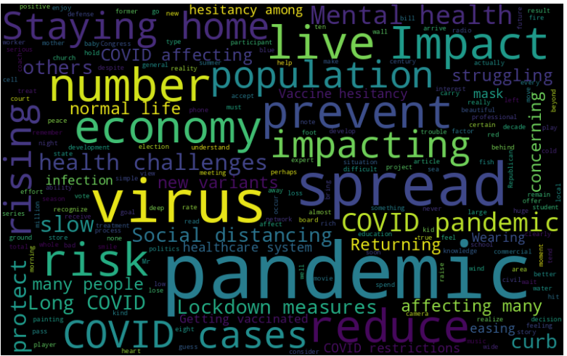
Word Cloud
Notes:
The word cloud highlights key themes in COVID-19 discussions, with dominant terms like virus, pandemic, COVID, and economy reflecting the focus on health and economic impacts. Words such as spread, risk, infection, and health challenges, emphasize concerns about managing the virus and its effects on public health. Social and lifestyle impacts are evident through terms like staying home, mental health, lockdown measures, and social distancing, showcasing how the pandemic disrupted daily life. Discussions around new variants and vaccine hesitancy indicate ongoing challenges in combating the virus and ensuring vaccination efforts. Overall, the word cloud captures the wide-ranging impact of COVID-19 on health, society, and the economy.

Slide 17
Predictive Modeling
We used ARIMA time series model and Random Forest Model
We evaluated the ARIMA model using a walk-forward validation.
Results
For cases the Test RMSE score is: 15467997.312
For Deaths the Test RMSE score is : 181367.090
Evaluation Metrics for Cases using Random Forest Model is:
RMSE: 43936506.53
R-squared (R²): 0.3972934738907907
Evaluation Metrics for Deaths using Random Forest Model is:
RMSE: 333870.90
R-squared (R²): 0.7350930077784933
Metric | ARIMA (Cases) | ARIMA(Deaths) | RF (Cases) | RF (Deaths)
RMSE | 15467997.312 | 181367.09 | 43936506.53 | 333870.90
R-squared (R²) | - | - | 0.397 | 0.735

Slide 18
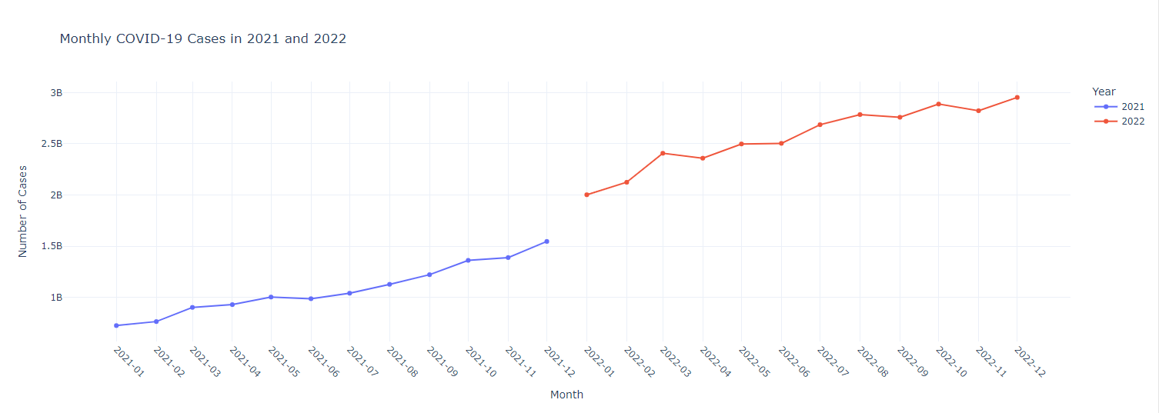
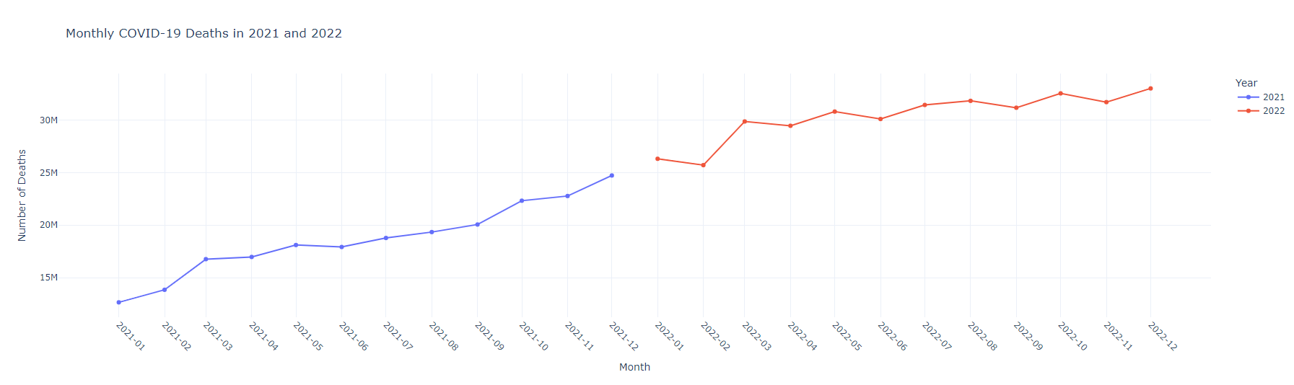

Slide 19
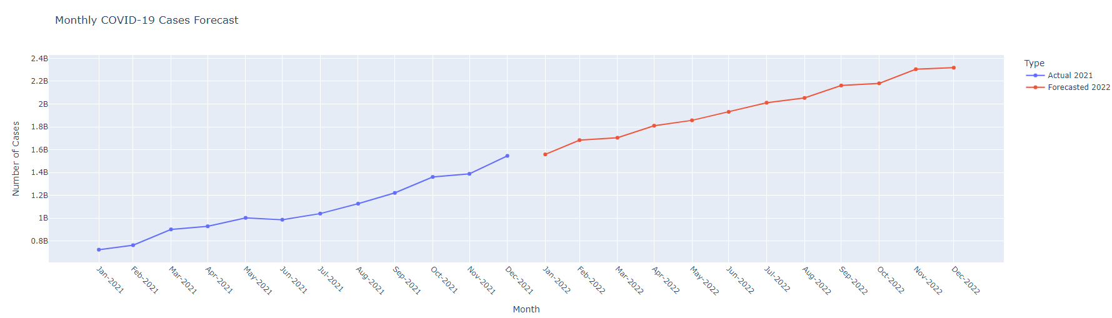
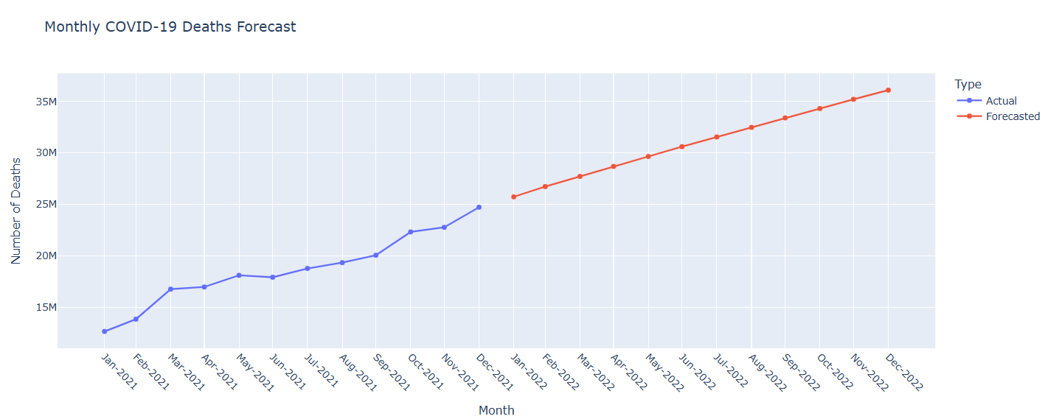
COVID-19 Cases Forecast - ARIMA Modeling

Slide 20
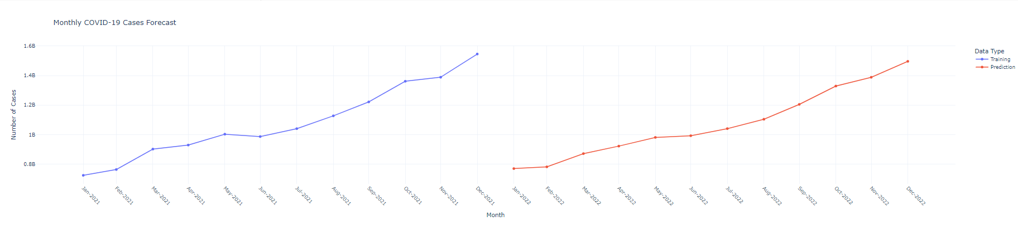
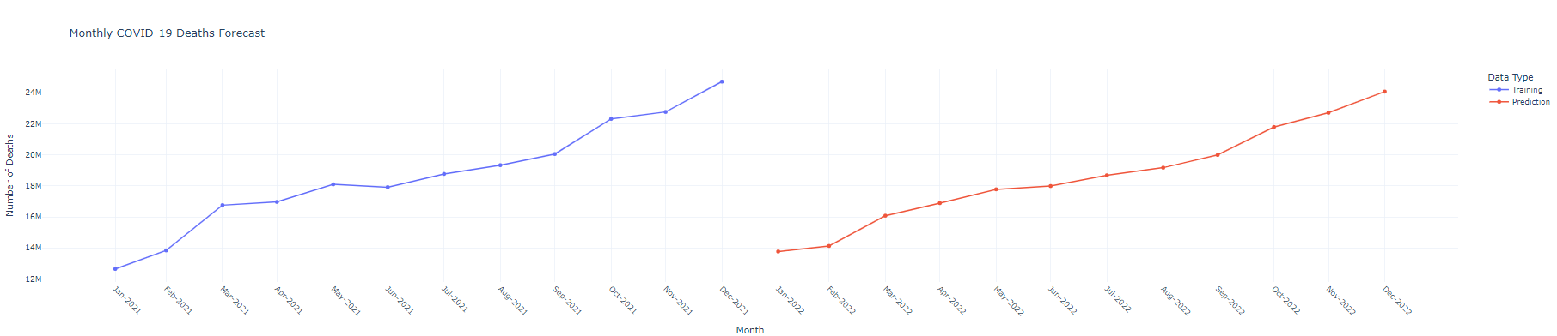
COVID-19 Forecast - Random Forest
Notes:
Works well with small to medium datasets
RF works best on non-linear relationships and when fluctuations in data
This works by averaging the predictions across multiple decision trees and deal with overfitting

Slide 21
Conclusion
Infection spikes in late 2021 and early 2022 were driven by Delta and Omicron variants, showing the virus's adaptability.
The gap between cases and deaths widened due to improved treatments and vaccines, though surges persisted.
Vaccination efforts initially reduced death rates but lost impact over time due to waning immunity and lower demand.
High-population states like California, Texas, and New York had the most cases and deaths due to density, healthcare strain, and policies.
Overall, sentiments fluctuate weekly, with neutral sentiment dominating, positive sentiment peaking in weeks 46–50, and dropping in week 52 due to Omicron concerns.
ARIMA time series model performed better in making predictions than Random Forest. RF performed poorly because of lack of enough training data.

Slide 22
Thank You

